Slide 1

Administration & SUPPORT SERVICES​
Pre-sessional English and academic study skills (PEASS) course
Lincoln Brayford campus - January 2022

Slide 2
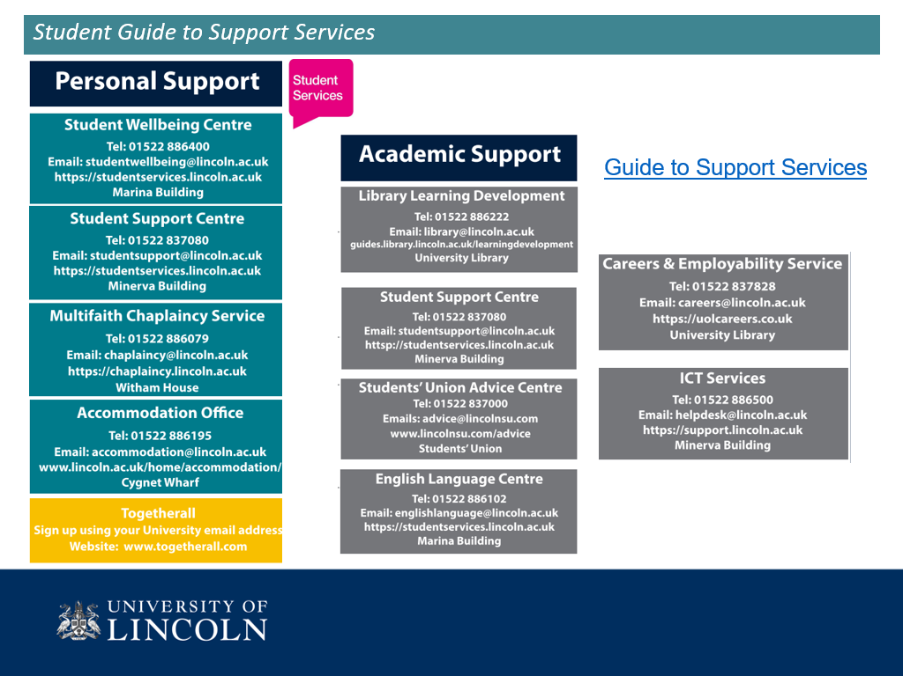

What happens now – ELC Admin Team
You should have:
1. enrolled in Runway
2. Paid the £1,650 PEASS course fee
3. Uploaded documents to Student Visa Compliance
Check student email account daily and respond immediately
Uploads can be rejected
Non-enrolled students will be withdrawn
Email englishlanguage@lincoln.ac.uk with any concerns

Slide 3



ICT Service Desk email: ict@lincoln.ac.uk
Expert technical support ​
Guides and tips on setting up and using university systems:​
    ict.lincoln.ac.uk/getting-started​
    ict.lincoln.ac.uk/howto​
Office 365* – sign in using Student email and password: www.365.lincoln.ac.uk​
*Office 365 is needed to access student emails in Microsoft Outlook and online teaching sessions, tutorials and online resources in Microsoft Teams

Slide 4

Residential Wardens
Support students living in University managed accommodation
Support 17:30 to 00:00 (Security team can connect students to the team outside these hours)
Want someone to talk to?
Interested in getting involved in social activities?
Having minor issues with shared accommodation areas?
Discover more from this presentation from Rebecca, Senior Residential Warden
Email: rw@lincoln.ac.uk
Mobile phone: 07971 589 326
Residential Wardens webpages

Slide 5

Student Wellbeing Service
Support, advice and guidance with any challenges or difficulties students can face
Concerns include; disability, learning differences, mental health or medical conditions, including anything that may cause emotional or psychological distress
Visit their webpages for useful online resources: General wellbeing advice
Watch the Student Wellbeing Presentation
studentwellbeing@lincoln.ac.uk

Slide 6

National Health Service (NHS)
Register with a Doctor (General Practitioner – GP)
On campus Health Centre, building number 5 on the Brayford Campus Map
Wear a face mask when visiting the Health Centre
You must register online here: University of Lincoln Health Service
NHS doctor is free – eye tests are not free
NHS is confidential
You must pay for NHS medicine/prescriptions
Obtain advice on vaccinations, some are free including Covid-19/booster
NHS Fact Sheets in different languages

Slide 7
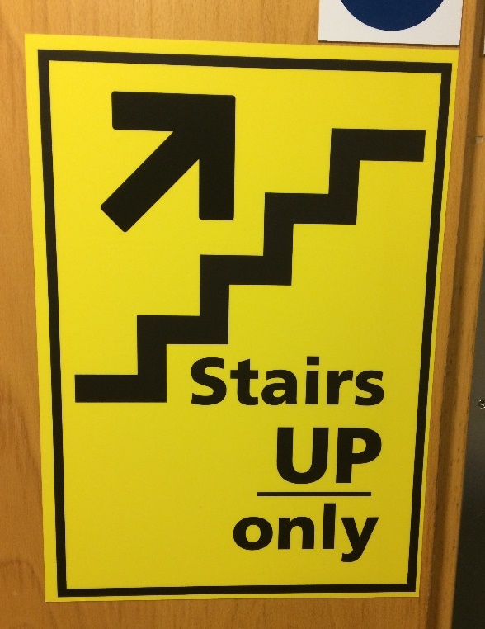

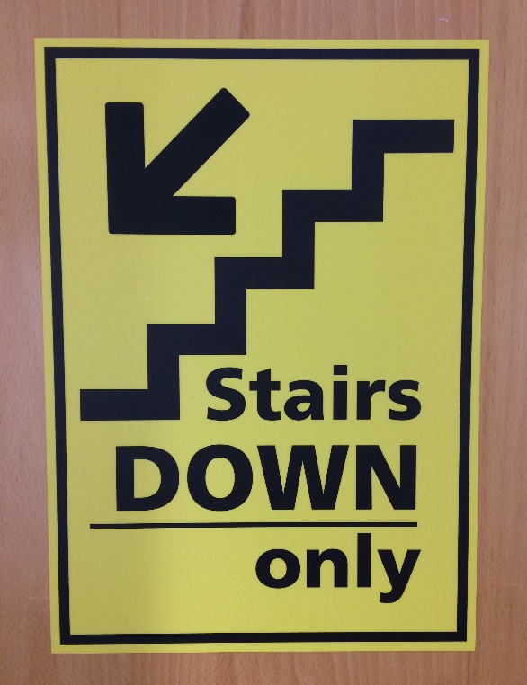

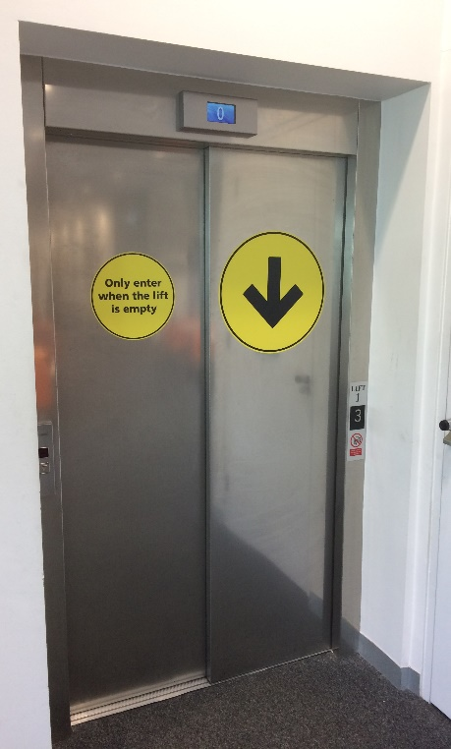
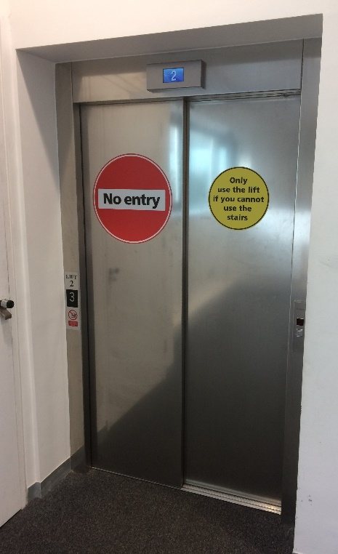
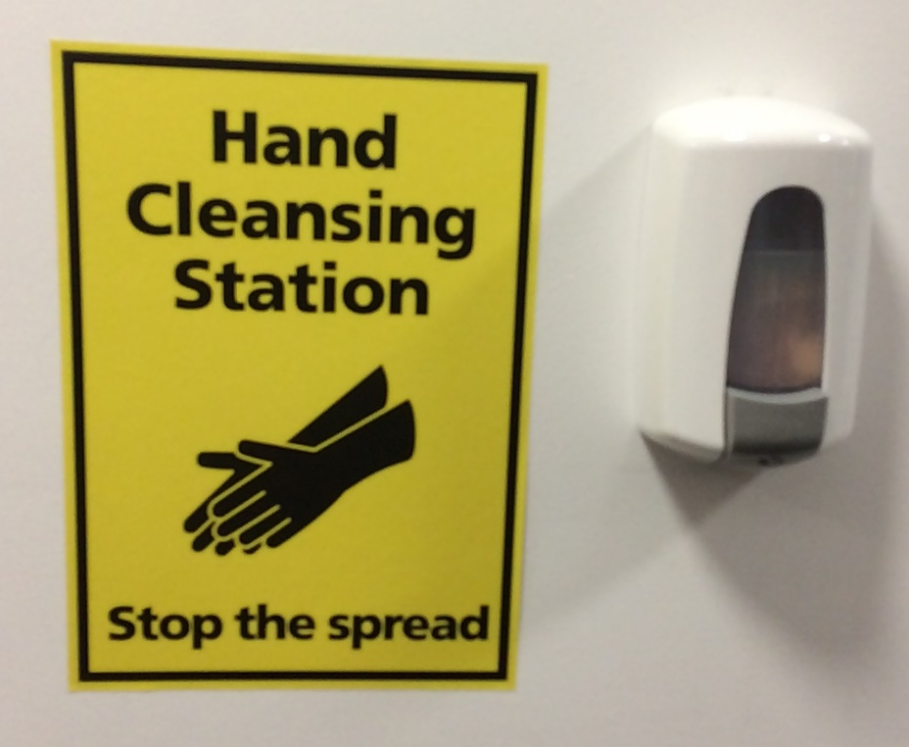
Health & Safety - On Campus safety – Covid-19
Wear a face covering in enclosed indoor public spaces, unless medically exempt
Follow one-way system inside buildings, including staircases
Walk on the left
Observe social distancing
Only use lifts if you cannot use stairs
Use hand cleansing stations provided

Slide 8
Health & Safety - On Campus safety – Covid-19
FOLLOW UK GOVERNMENT GUIDELINES
STAY IN ACCOMMODATION TO COMPLETE QUARANTINE
No symptoms:
Self-administer twice weekly lateral flow test (LFT)
Free boxes of tests available from Student Support Centre, Student Wellbeing Centre, University Library and Students’ Union Advice Centre
If positive self-isolate immediately
Remember HFSA
Hands - wash your hands frequently.
    Face - wear a face covering in enclosed spaces.
    Space - maintain social distancing wherever possible.
    Adhere to any local or national restrictions
    Comply with Government guidelines www.gov.uk/coronavirus.
Coronavirus Information | Home | University of Lincoln

Slide 9
Health & Safety
Classroom and On Campus safety – Covid-19
If you have symptoms:
Self-isolate immediately, even if symptoms are mild
Book a PCR test via www.nhs.uk/coronavirus, or phone 119
Tell University Test and Trace team.
Tell English Language Centre englishlanguage@lincoln.ac.uk
Ask for help if needed from studentsupport@lincoln.ac.uk
Follow the latest Government advice at www.gov.uk/coronavirus.
Coronavirus Information | Home | University of Lincoln

Slide 10
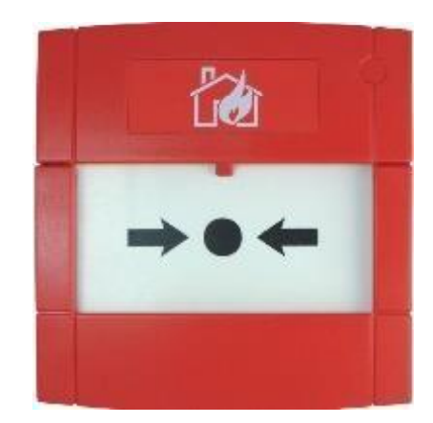
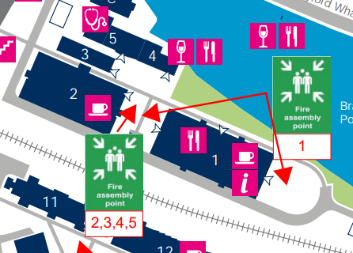

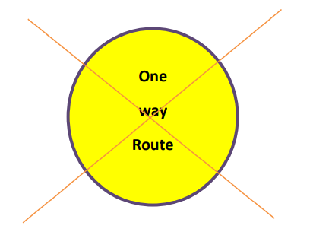
Health & Safety
Classroom and On Campus safety – Fire Alarm & Evacuation
On discovering a fire operate the nearest Call Point
Lifts MUST NOT be used during a Fire Alarm
Ignore Covid-19 one-way systems on hearing a Fire Alarm
Leave calmly by the nearest Emergency Exit
If you have mobility issues email englishlanguage@lincoln.ac.uk
Proceed to nearest Fire Assembly Point (from classroom MB2301 go to the paved area at the back of Minerva Building)

Slide 11





Health & Safety
Classroom and On Campus safety
Health & Safety Student Induction video
Become familiar with health and safety signs
Security Tel: 01522 886062 (store in phone)

Slide 12

Contact English Language Centre
The PEASS Pod contains useful information and contacts for PEASS Students: https://elc.lincoln.ac.uk/peass-pod/
English Language Centre staff are available
Monday to Thursday 08:30 to 17:00
and Friday 08:30 to 16:30
englishlanguage@lincoln.ac.uk

